Slide 1

CHICKEY
PROJECT GUIDE
RAJI MISS
PRESENTED BY : BENCY

Slide 2
ABSTRACT
Online ordering system will be a web based application whose main language of programming will be PHP.
Its main aim is to simplify and improve the efficiency of the ordering process for both customer and restaurant, minimize manual data entry and ensure data accuracy and security during order placement process.
Customers will also be able to view product menus and there ingredients and be able to have a visual confirmation that the order was place correctly

Slide 3
MODULES OF PROJECT
MOBILE APPLICATION ( ANDROID & IOS APPLICATION)
WEB PORTAL

Slide 4
MOBILE APPLICATION ( ANDROID & IOS )
SIGN UP
SIGN IN
PRODUCT CATEGORY
PRODUCT LISTING
PRODUCT SINGLE PAGE
ADD-ON PAGE
CART PAGE
PAYMENT GATE WAY
HOME DELIVERY
PICKUP
ABOUT PRODUCT
CONTACT US
SUGGESTION

Slide 5
WEB PORTAL
SIGN IN
SEE ALL REGISTERED USERS
ADD/EDIT/DELETE PRODUCTS
ADD/EDIT/DELETE CATEGORIES
VIEW PENDING ORDERS
OPTION TO FILTER PENDING/COMPLETED ORDERS

Slide 6
1. DETAIL REQUIREMENT SPECIFICATION (MOBILE APPLICATION)
SIGNUP
A new user can sign up by entering the following fields
Name
Mobile Number
Street
Zip code
Email
Password
Confirm Password
SIGN IN
User can sign in by entering the username and password

Slide 7
PRODUCT CATEGORY
Categorize the product based on market
PRODUCT LISTING
List the product based on different category and filter the product based on the category.
PRODUCT SINGLE PAGE
Detail description of the product
Product details
Product recipe
Product Price
Option to add or minimize the product quantity
Option to select corresponding add-on
Option to add more products
Display total price

Slide 8
ADDON PAGE
Display all addons
We can choose the quantity
Display addon price
Option to add or minimize the quantity of addon
Display total price of addon
CART PAGE
See all products we listed
See quantity we ordered
Price of each product
Total price
Option to add or minimize product
Option to remove product

Slide 9
PAYMENT GATEWAY INTEGERATION
Option to give online payment
Paypal (‘A gateway for the payment’) is the API used for it
HOME DELIVERY
User can enter his/her address a list
User can select location by using map
Google Map API Integration

Slide 10
PICK UP
User can enter his/her address a list
User can select location by using map
Google Map API Integration
ABOUT CHICKEY
User can read company profile
Who we are
Our Vision
Our Mission

Slide 11
CONTACT US
Option send queries to admin
Option to send mail to admin
Option to call admin
SUGGESTIONS
If there any bugs or vulnerability they can report from user app will display on this module.

Slide 12
2. DETAIL REQUIREMENT SPECIFICATION (WEB PORTAL)
SIGN IN
To Sign in to web portal by entering the username and password
2. SEE ALL REGISTERED USERS
Option to see all Users who registered by using mobile app
Option to remove user
Option to send message to user
3. ADD/EDIT/DELETE PRODUCTS
Option to add new products
Option to edit a current product
Option to delete a new product

Slide 13
4. ADD/EDIT/DELETE CATEGORIES
Option to add new categories
Option to edit a current categories
Option to delete a new categories
5. VIEW PENDING ORDERS
Option to see all pending orders
Option to change status from pending to complete
6. OPTION TO FILTER PENDING/COMPLETED ORDERS
Option to filter the orders
Option to see all completed orders
Option to see all pending orders

Slide 14
Netbeans
NetBeans IDE is a free, open source, integrated development environment (IDE) that enables you to develop desktop, mobile and web applications.
The IDE supports application development in various languages, including Java, HTML5, PHP and C++. The IDE provides integrated support for the complete development cycle, from project creation through debugging, profiling and deployment.
The IDE runs on Windows, Linux, Mac OS X, and other UNIX-based systems.

Slide 15
The IDE provides comprehensive support for JDK 7 technologies and the most recent Java enhancements. It is the first IDE that provides support for JDK 7, Java EE 7, and JavaFX 2.
The IDE fully supports Java EE using the latest standards for Java, XML, Web services, and SQL and fully supports the GlassFish Server, the reference implementation of Java EE.

Slide 16
Introduction to PHP
PHP is a server-side scripting language designed for web development but also used as a general-purpose programming language. PHP code is usually processed by a PHP interpreter, which is usually implemented as a web server's native module or a Common Gateway Interface (CGI) executable. After the PHP code is interpreted and executed, the web server sends resulting output to its client, usually in form of a part of the generated webpage; for example, PHP code can generate a web page's HTML code, an image, or some other data. PHP has also evolved to include a command-line interface (CLI) capability and can be used in standalone graphical applications.

Slide 17
My SQL
Structured Query Language (SQL), in computer science, a database sub language used in querying, updating and managing relational databases. MY SQL Server is a relational database management system for distributed Client-Server computing. Like all other database management systems, it provides the following features:
A variety of user interfaces
Physical data independence
Logical data independence
Query optimization
Data integrity
Concurrency control
Backup and recovery
Security and authorization

Slide 18
Android
Android is a mobile operating system developed by Google, based on the Linux kernel and designed primarily for touch screen mobile devices such as smart phones and tablets. Android's user interface is mainly based on direct manipulation, using touch gestures that loosely correspond to real-world actions, such as swiping, tapping and pinching, to manipulate on-screen objects, along with a virtual keyboard for text input.

Slide 19
IONIC FRAMEWORK
Ionic is a powerful HTML5 SDK that helps you build native-feeling mobile apps using web technologies like HTML, CSS, and JavaScript.Ionic is focused mainly on the look and feel, and UI interaction of your app. That means we aren't a replacement for PhoneGap or your favourite JavaScript framework. Instead, Ionic simply fits in well with these projects in order to simplify one big part of your app: the front end. We recommend reading, Where does the Ionic Framework fit in? to get a good understanding of Ionic's goals.

Slide 20
SYSTEM SPECIFICATION
Hardware specification
Processors : Intel Premium Pro or Processor running at 133 MHz
Hard Disk : 1.2 GB Hard Disk
RAM : Client Level – Minimum 128MB
Recommended Requirements for peak performance
RAM : Client Level – Minimum 512MB
Display Type : SVGA Colour Enhanced Monitor
Mouse : PS/2 2 Button

Slide 21
Software specification
Front End Tool : HTML, JavaScript, CSS, Twitter Bootstrap, Android, Ionic
Back End Tool : PHP, MySQL
Development tools : Net Beans
Operating System : Windows XP 7 Professionals and Higher
Browse : Google Chrome. Mozilla Firefox

Slide 22
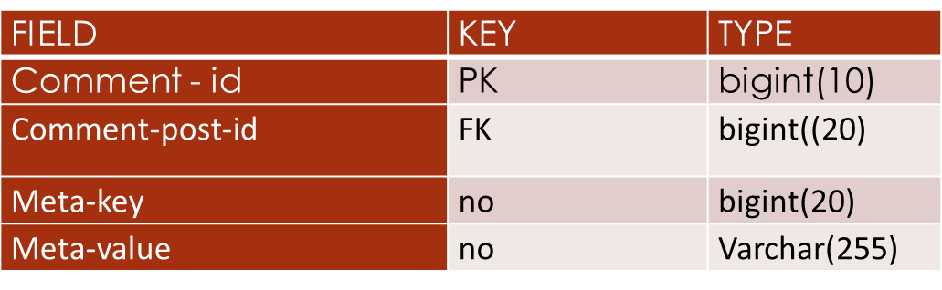
TABLES
Tbl_commentmeta

Slide 23
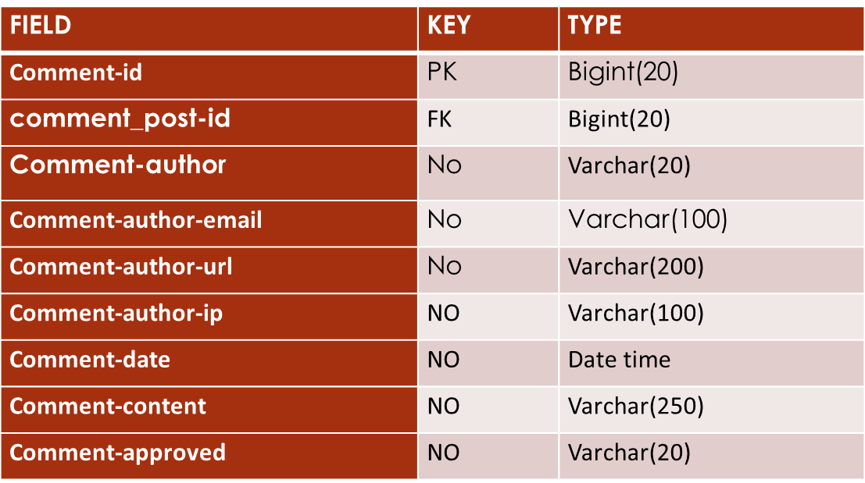
Tbl_comments

Slide 24
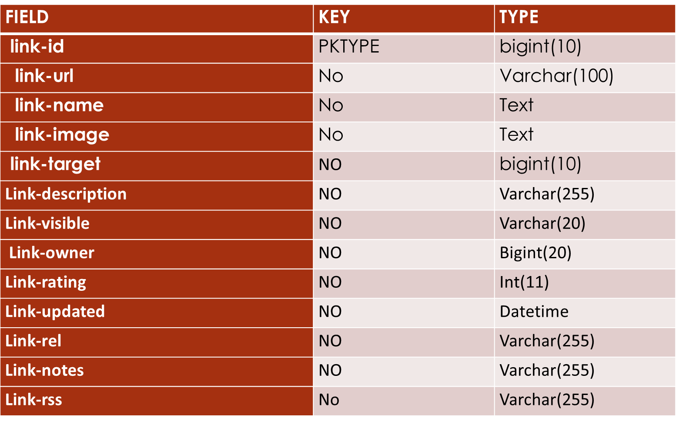
Tbl_links

Slide 25
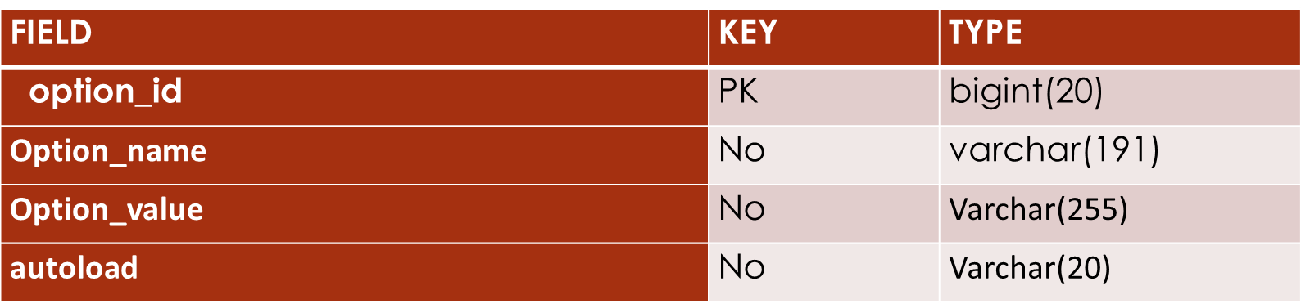
Tbl_option

Slide 26
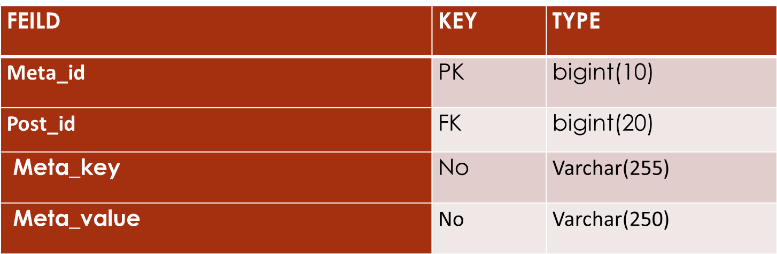
Tbl_postmeta

Slide 27
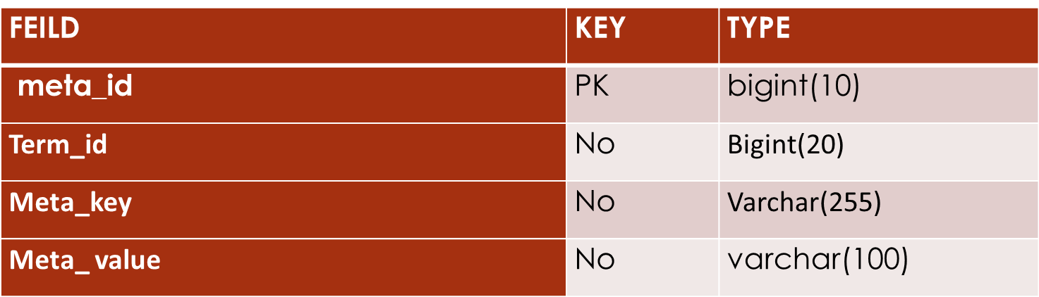
Tbl_temmeta

Slide 28
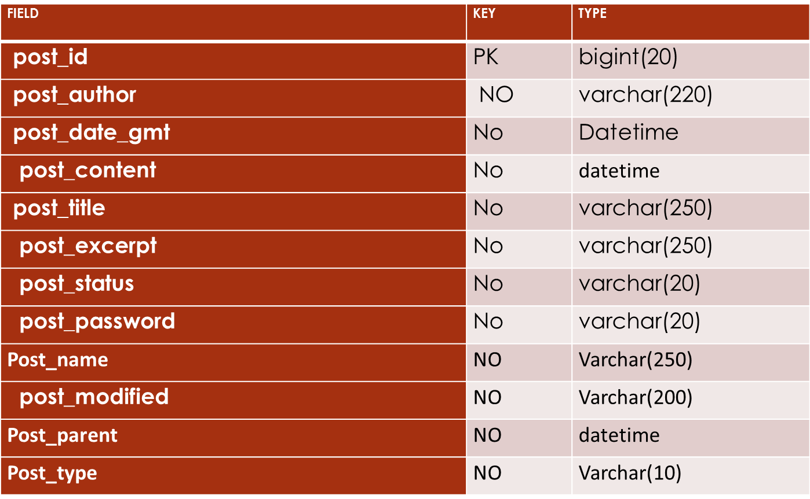
Tbl_posts

Slide 29
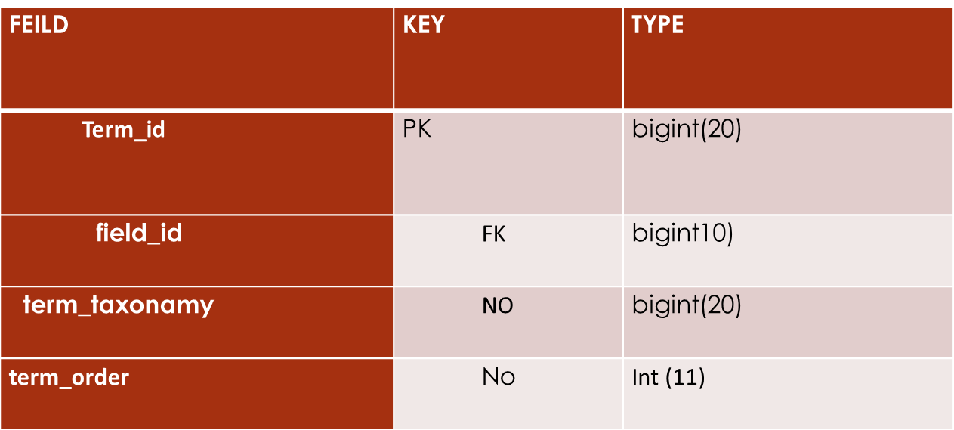
Tbl_term

Slide 30
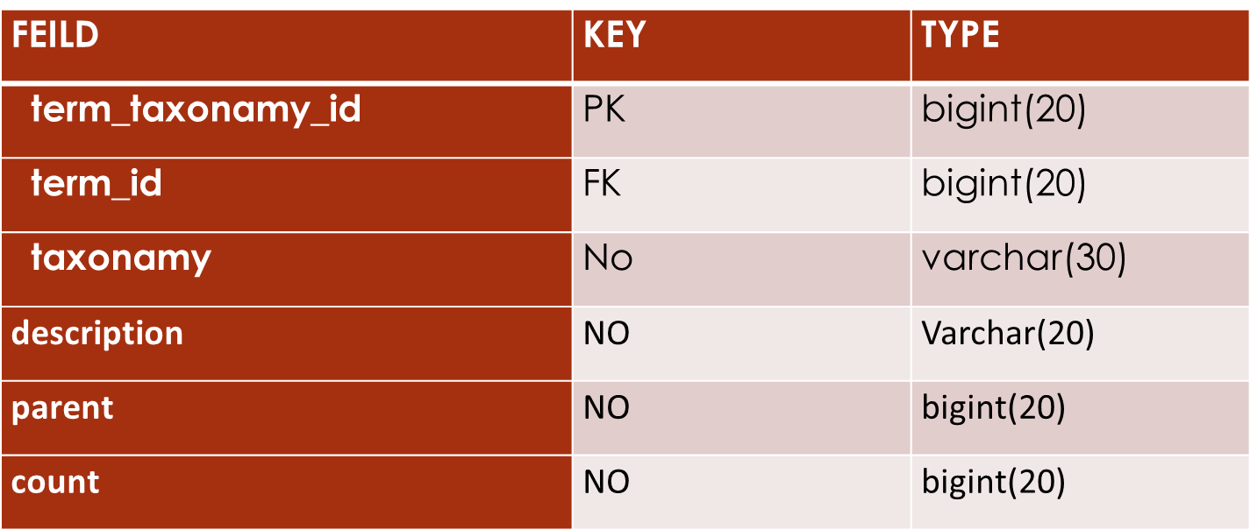
Tbl_term_taxonamy

Slide 31
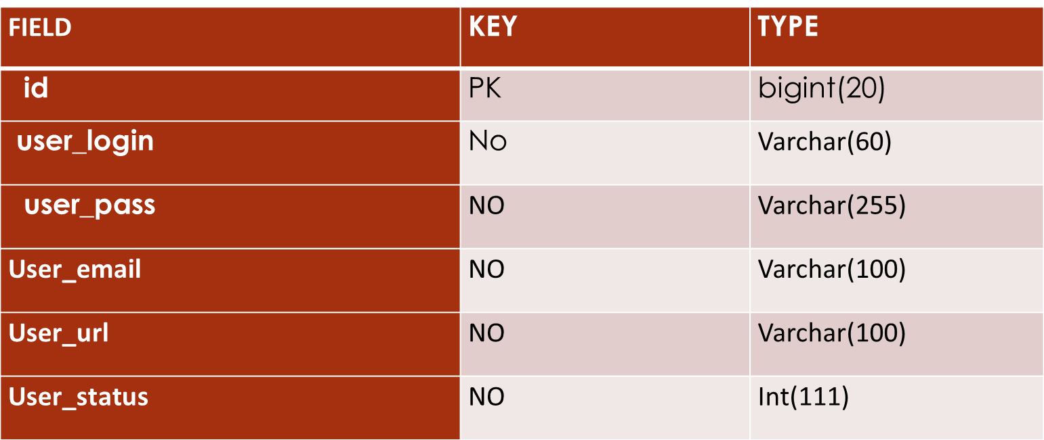
Tbl_users

Slide 32
UML DIAGRAM

Slide 33
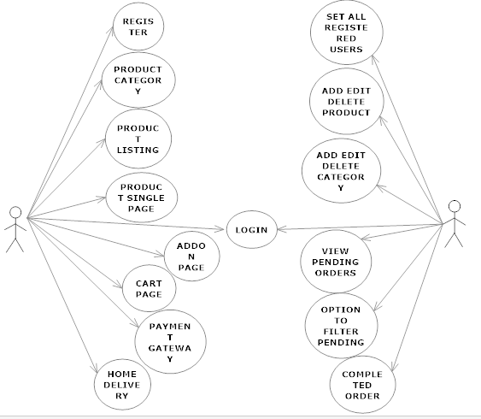
USE CASE DIAGRAM

Slide 34
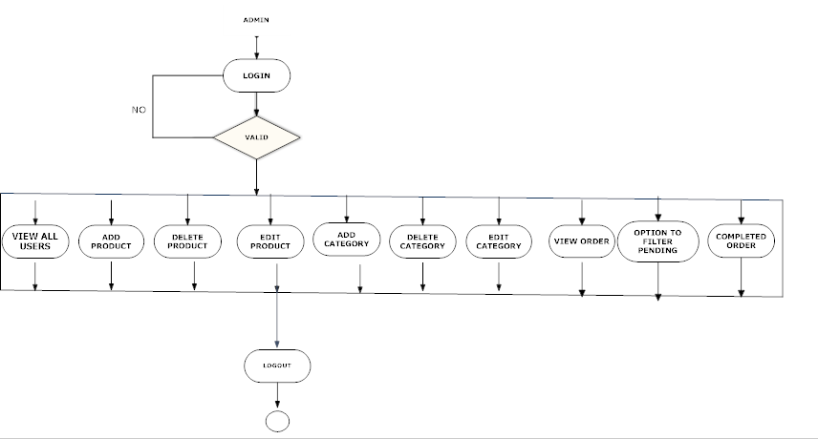
ACTIVITY DIAGRAM
ADMIN

Slide 35
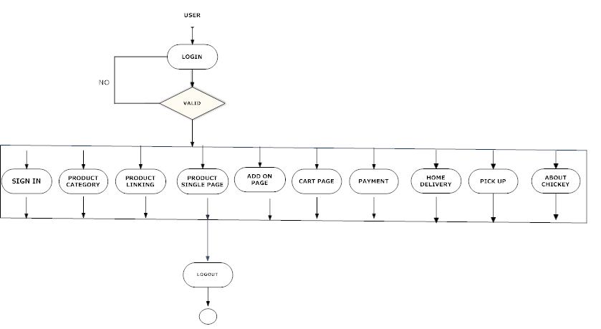
USER ACTIVITY

Slide 36
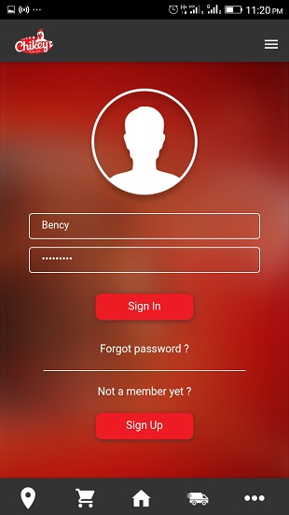
FORMS LOGIN FORM

Slide 37
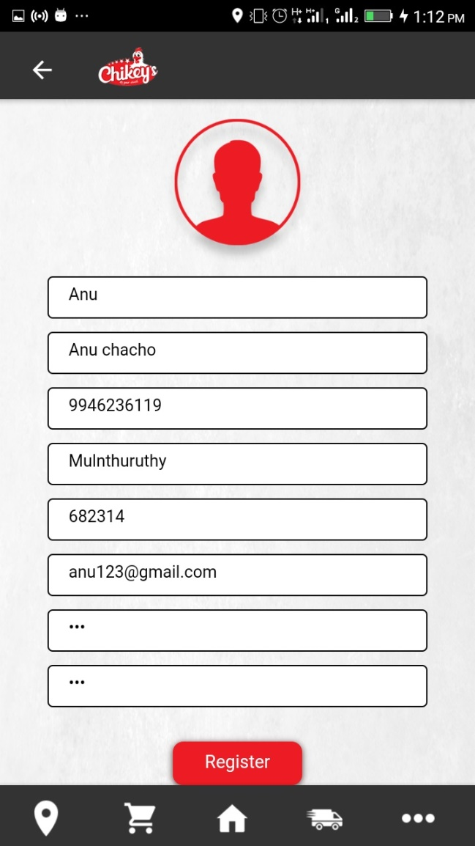
REGISTRATION

Slide 38
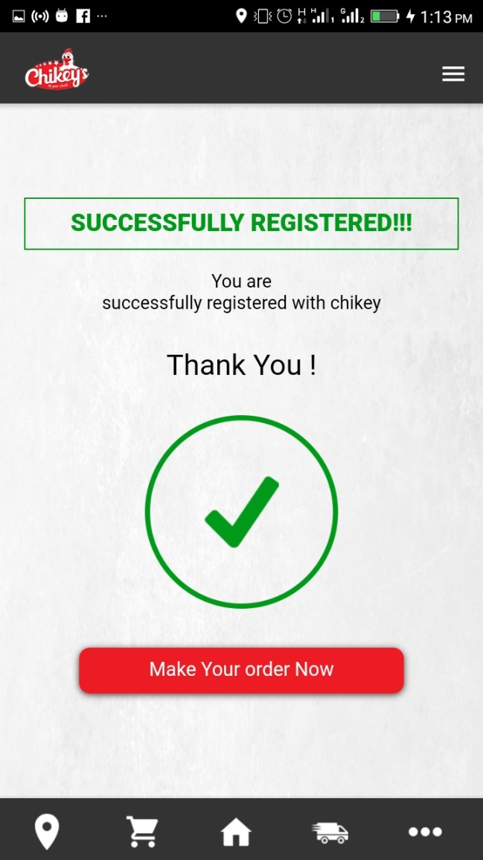
REGISTRATION SUCCESSFULL

Slide 39
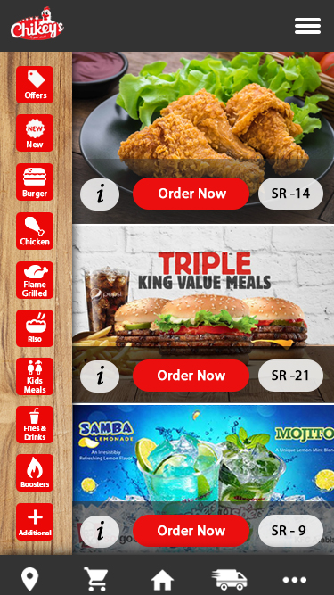
HOME PAGE

Slide 40
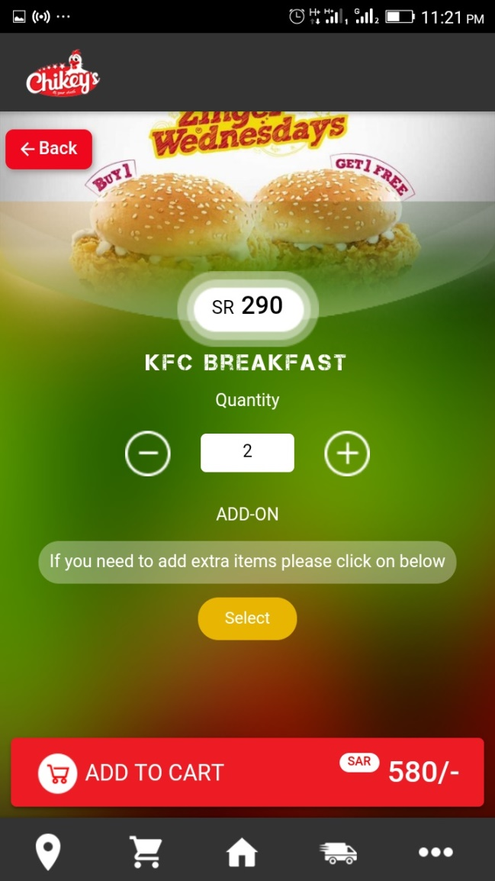
CART PAGE

Slide 41
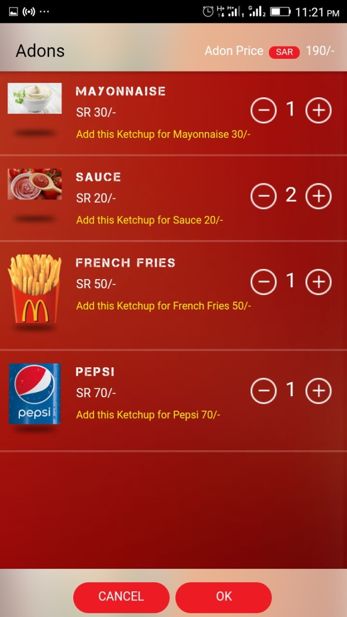
ADD ON PAGE

Slide 42
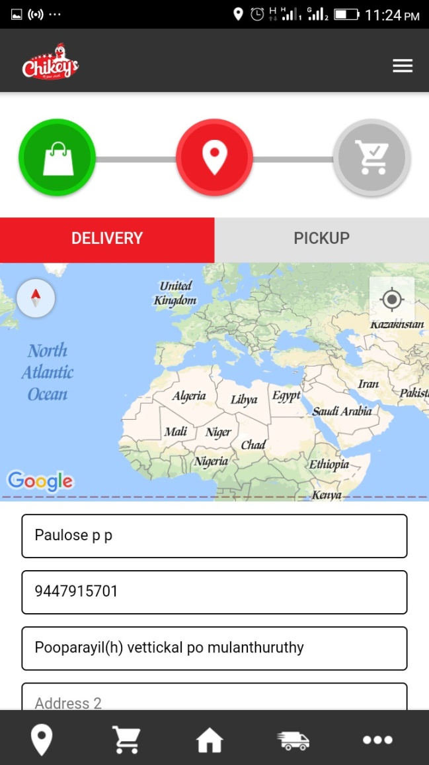
DELIVERY PAGE

Slide 43
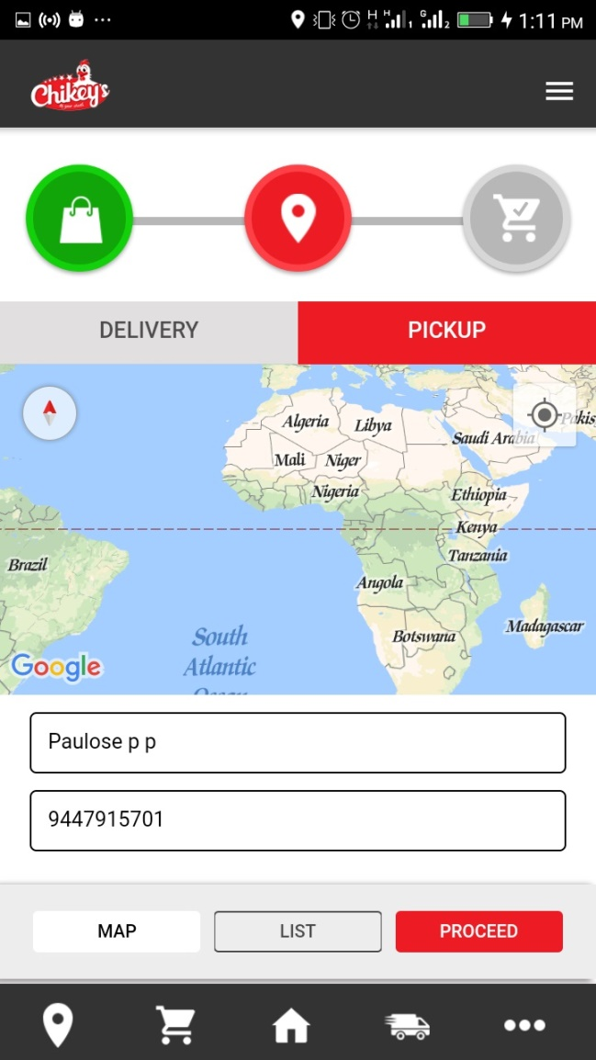
PICK UP PAGE

Slide 44
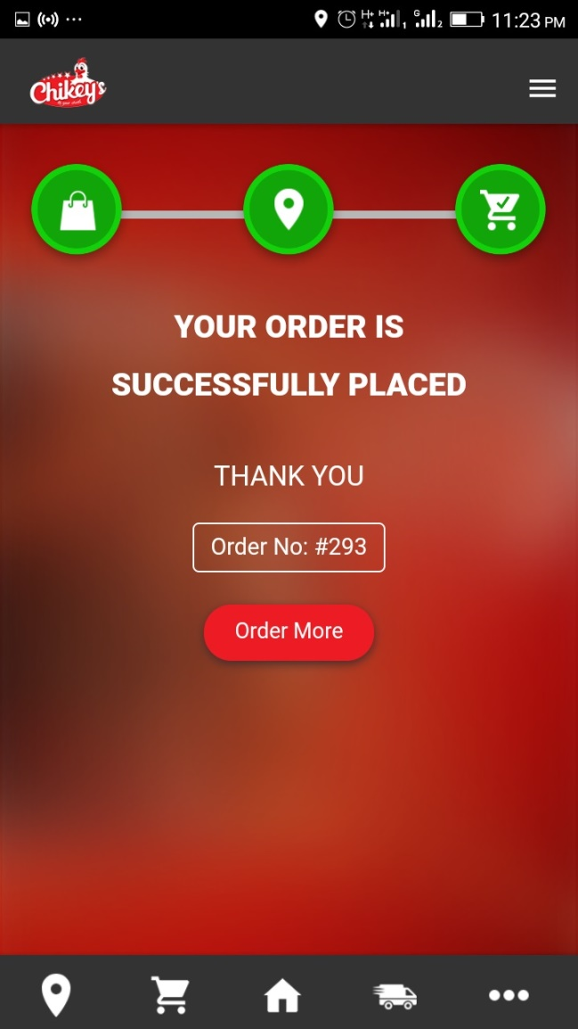
ORDER SUCESSFULL

Slide 45
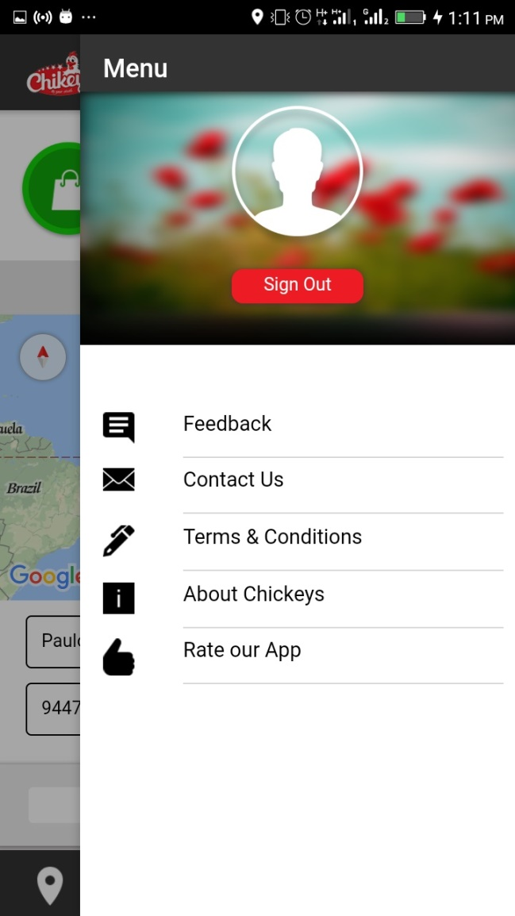
Menus

Slide 46
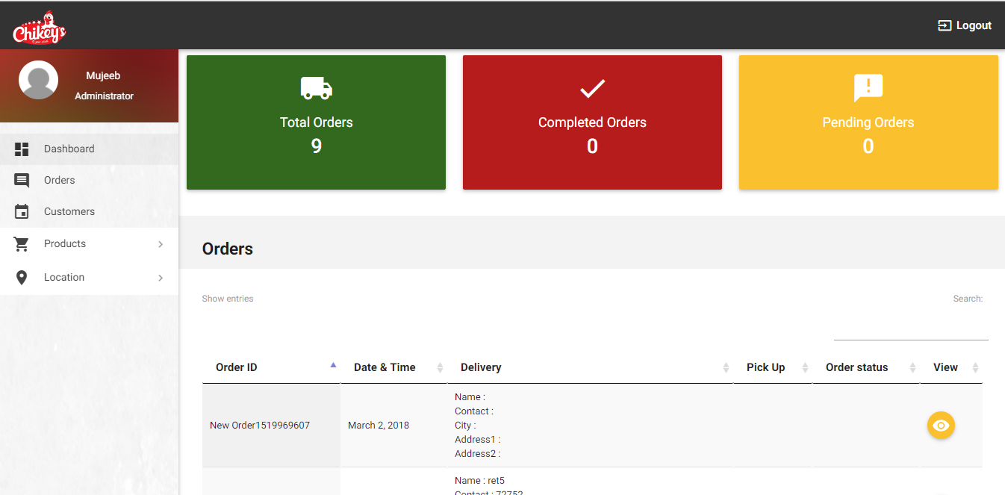
WEB PORTAL DASHBOARDS

Slide 47
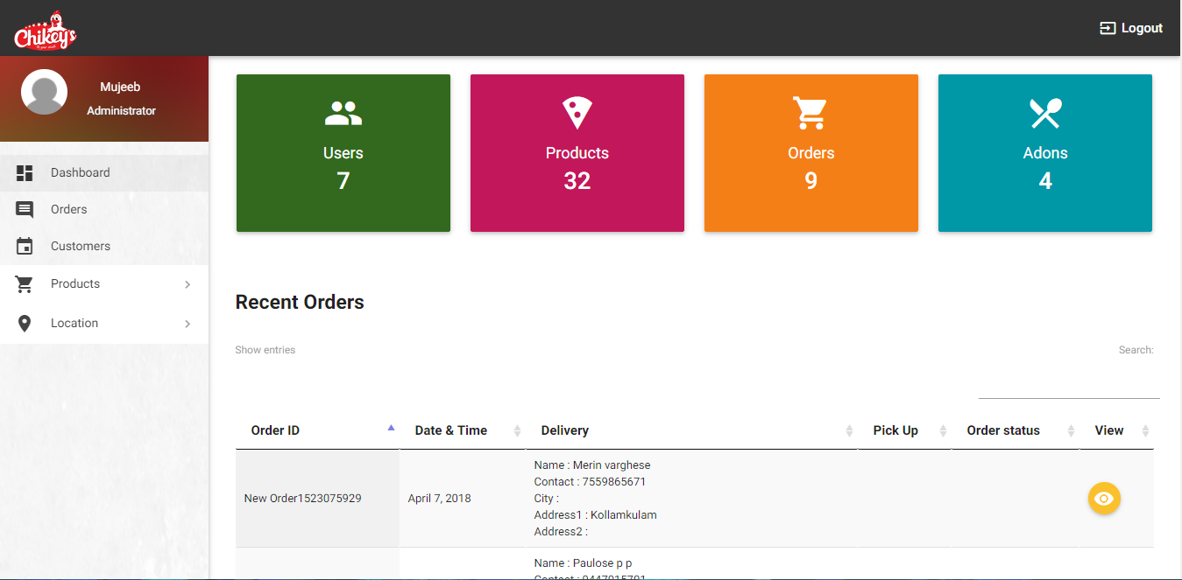
CUSTOMERS

Slide 48
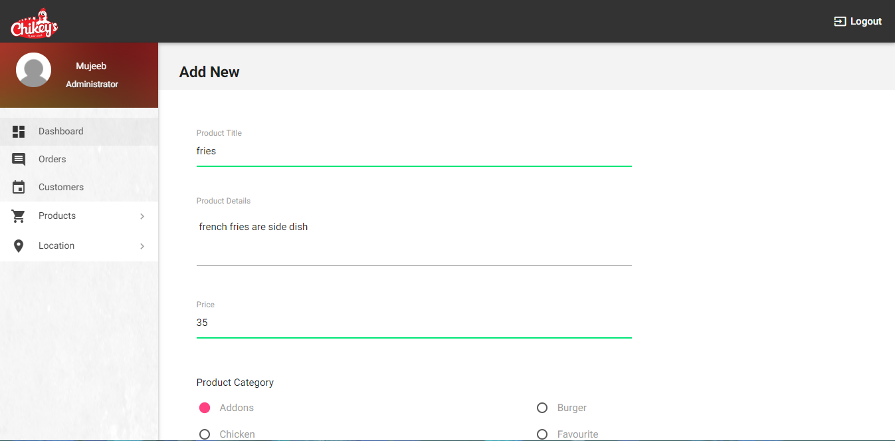
ADD NEW

Slide 49
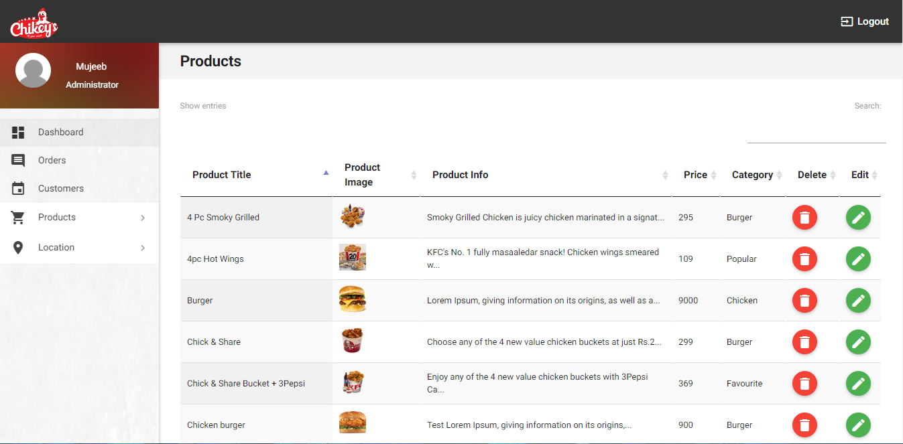
PRODUCTS

Slide 50
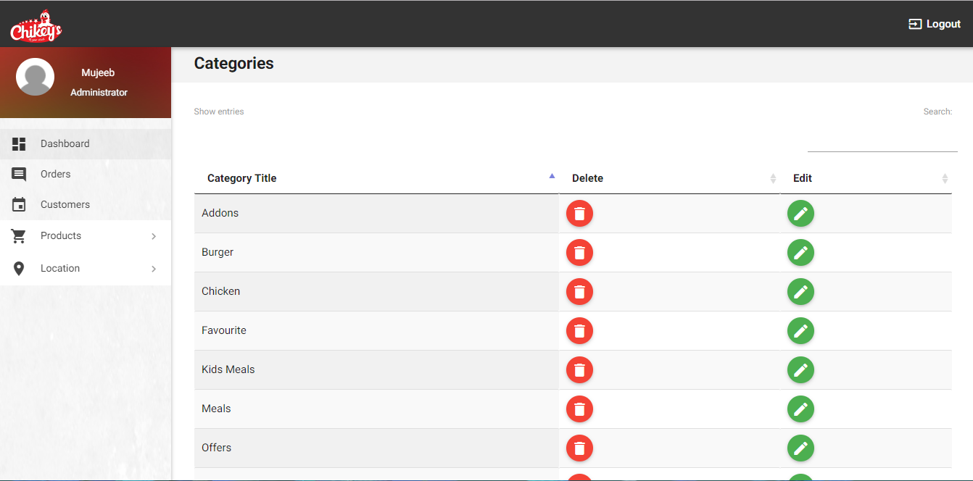
CATEGORIES

Slide 51
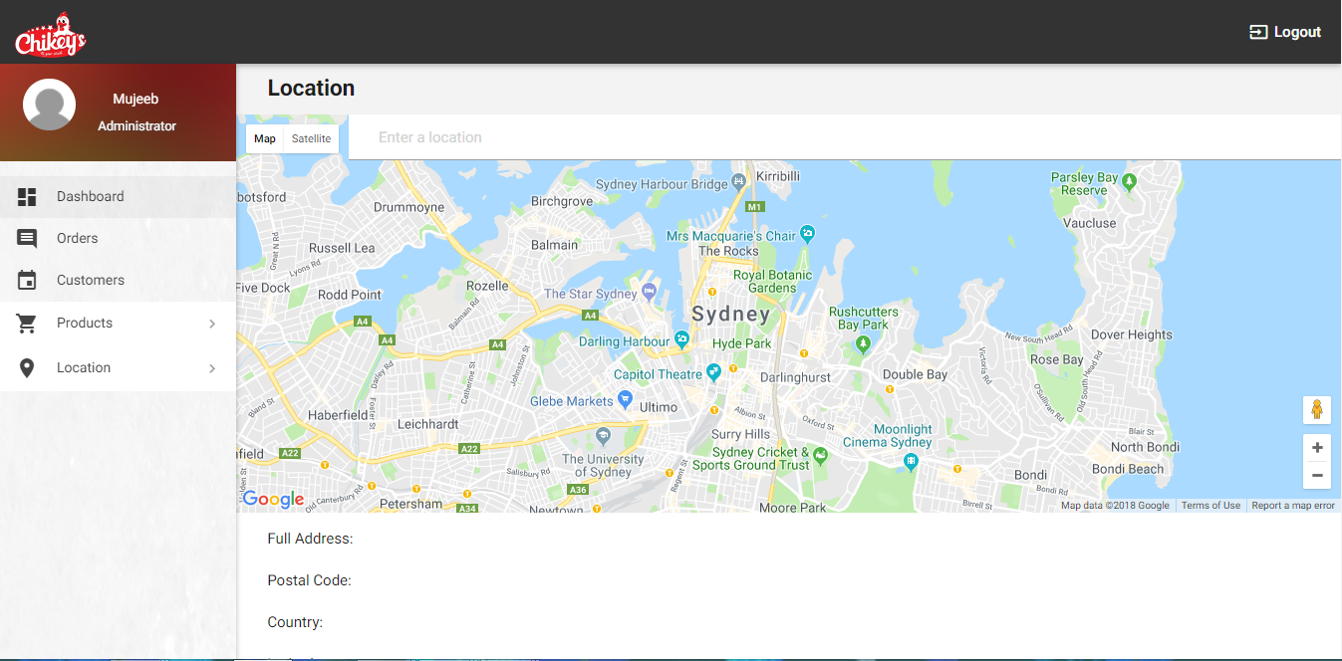
LOCATION

Slide 52
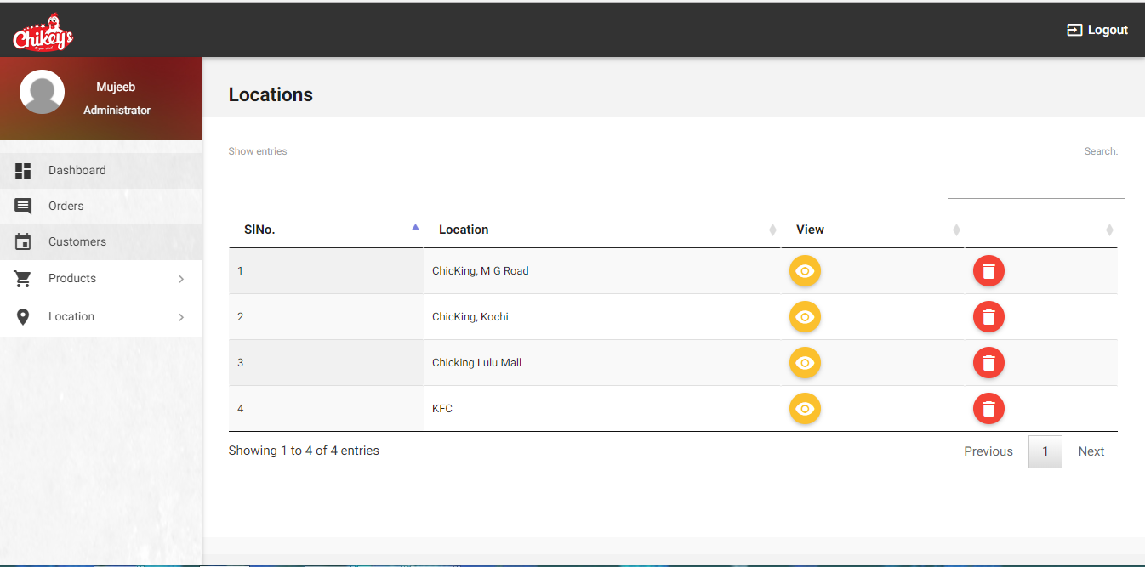
VIEW AND EDIT LOCATIONS

Slide 53
REFERENCES
WWW.GOOGLE .COM
WWW.MOZILLA FIREFOX .COM

Slide 54
THANK YOU

